Slide 1
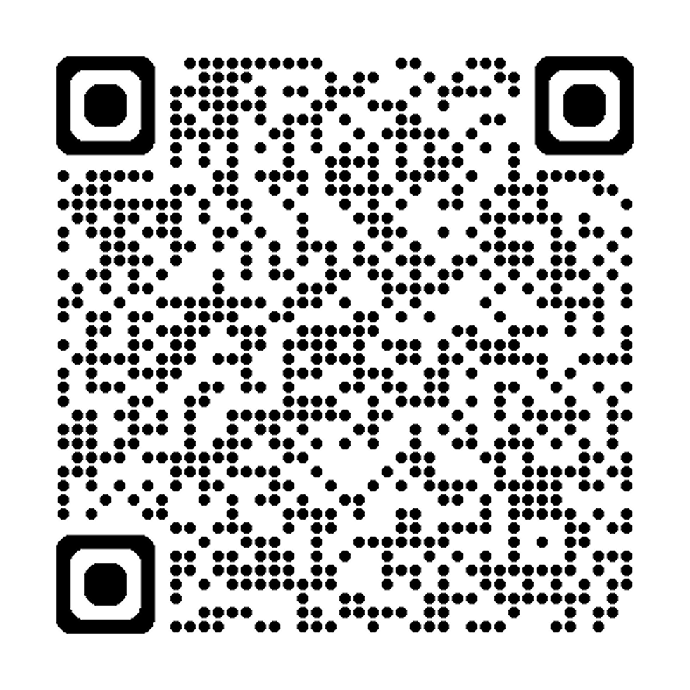
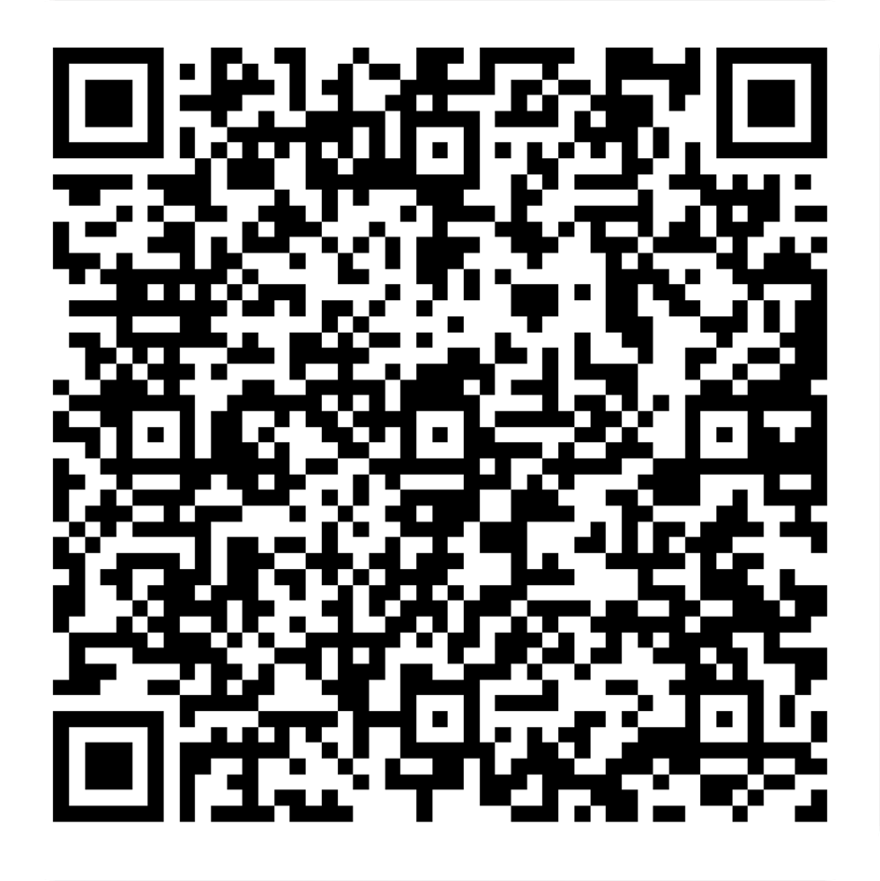
Microsoft Build 2025 Watch Party + Era of AI Day
AGENDA ↓
FEEDBACK ↓

Slide 2
Agenda
TIME | SESSION DETAILS
9:00 – 9:30 AM | Registration and coffee
9:30 – 10:00 AM | Theater: Welcome and Introduction MPR: Overflow
10:00 – 11:30 AM | Theater: 30 Minutes about 365 Copilots – Jay Leask Theater: The Business Value of Generative AI – Kiran Bakshi & Viktor Radu MPR: AI Infrastructure: BUILDing the Future – Vlad Tomsa
11:30 – 12:00 PM | Lunch provided
12:05 – 1:30 PM | Theater: Microsoft Build 2025 Keynote (Satya Nadella livestream) MPR: Overflow
2:15 – 3:15 PM | Theater: Build Agent-First Solutions – Ryan Cunningham & Evan Lew MPR: Microsoft 365 Copilot’s OOTB Agents – Melissa Hubbard
3:30 – 4:00 PM | Theater: Wrap-up & Closing Remarks MPR: Overflow

Slide 3
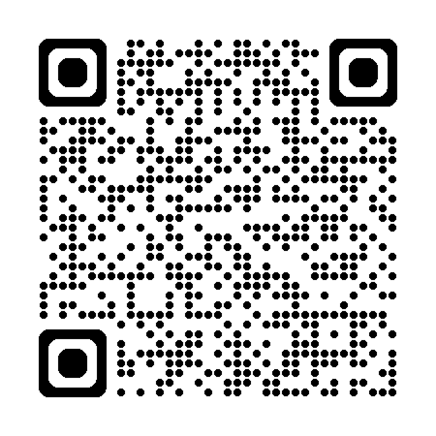
30 Lines about 365 Copilots An AI-Generated Song by Jay Leask
An ode to Microsoft 365 Copilot — inspired by “88 Lines about 44 Women” by The Nails
SCAN TO LISTEN ↓

Slide 4
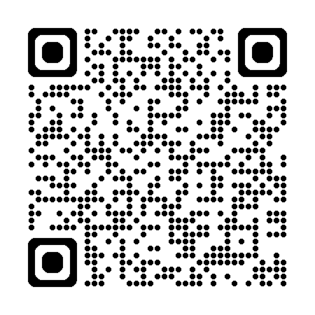
Thank You to Our Lunch Sponsor!
Software and solutions for Microsoft 365 and Azure.
LEARN MORE ↓

Slide 5
Share Your Experience!
We’d love to see your highlights from today!
Snap photos, share insights, and tag us in your posts using:
#M365DC | #MSBuild | #CommunityLuv | #MGCI

